Slide 1


Customer Feedback & Roadmap Alignment
Executive Strategy Report for Product Leadership

Slide 2

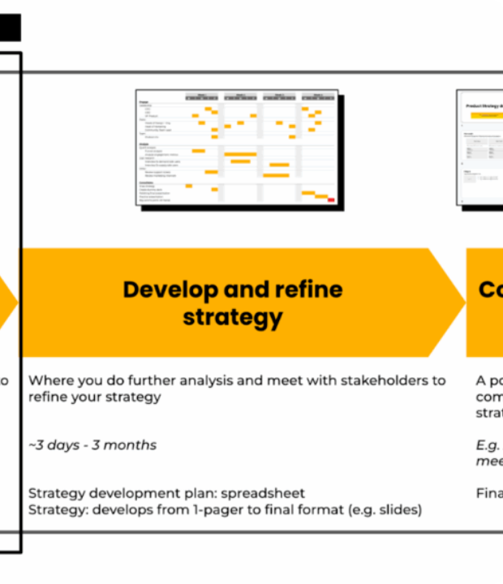

Executive Summary
This report bridges user feedback data with upcoming roadmap plans to maximize feature adoption and retention.
Strategic Alignment Goal
Ensure 80%+ of high-impact customer requests directly map into upcoming release cycles to reduce churn and accelerate product-market fit.

Slide 3
PART 01
Customer Feedback Overview
Analysis of incoming user sentiment, categories, and priority demand.

Slide 4
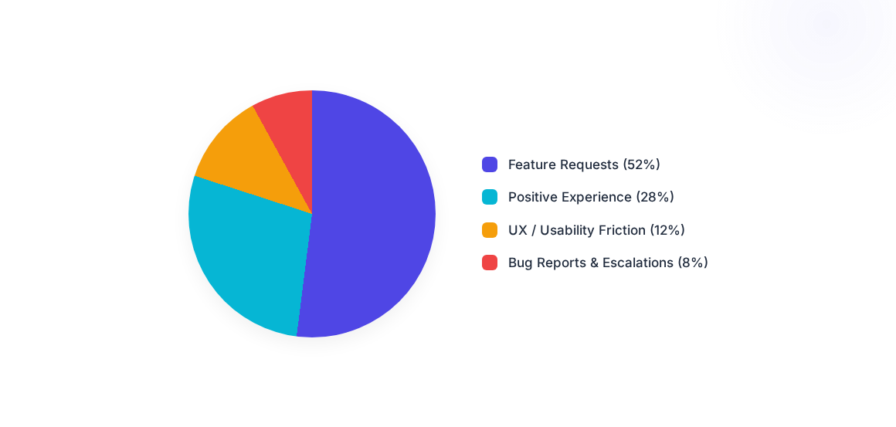
Feedback Sentiment & Categories

Slide 5
Top Customer-Requested Features
Requested Feature | User Segment | Volume | Churn Risk | Roadmap Status
Advanced Analytics & Export | Enterprise | 420 requests | High Risk | Planned for Q2
Custom Workflow Automation | Mid-Market | 310 requests | High Risk | Planned for Q3
Granular Role Permissions | Enterprise | 245 requests | Medium Risk | In Review
Dark Mode UI Support | All Users | 190 requests | Low Risk | Planned for Q1

Slide 6
PART 02
Roadmap & Alignment KPIs
Evaluating feature releases against key operational performance metrics.

Slide 7




Roadmap Schedule & Milestone Releases
Q2 - Enterprise Expansion
Q4 - Scalability & AI
Advanced Analytics, custom reporting dashboard, and export APIs.
Granular RBAC, AI insights assistant, and infrastructure upgrades.
Q1 - Quick Wins
Q3 - Automation Focus
Dark Mode, performance optimizations, and UI polish items.
Workflow automation builder and third-party app integrations.

Slide 8



Roadmap Alignment KPIs
84%
+24
92%
Feedback Coverage
Expected NPS Lift
SLA Adherence
Top customer requests addressed in roadmap.
Projected Net Promoter Score increase post-release.
On-time feature execution rate for key releases.

Slide 9


Scenario Analysis: Prioritization
Customer-First Scenario
Business-First Scenario
Primary Focus: Resolving immediate customer friction and top requested features.
Primary Focus: Building revenue-generating enterprise features and market expansion.
Pros: Maximize short-term retention and CSAT (+30%).
Pros: Accelerates new logo ARR acquisition (+25%).
Trade-offs: Delays net-new innovative platform capability releases.
Trade-offs: Risks elevated churn among existing power users.

Slide 10









Strategic Release Recommendations
Quick Wins (Q1)
Core Value (Q2-Q3)
Strategic Bets (Q4)
Prioritize high-demand low-effort items like Dark Mode and UI cleanup to show immediate responsiveness.
Deliver Advanced Analytics & Workflow Automation to secure key enterprise renewals and reduce churn risk.
Invest in Granular RBAC and AI Automation to unlock enterprise sales pipeline growth for next fiscal year.

Slide 11
Next Steps for Product Leadership
Finalize Q1 Scope: Lock engineering backlog for high-volume quick wins by end of sprint.
Align Engineering Resources: Reallocate 30% dev capacity to Enterprise Analytics feature set.
Customer Advisory Sync: Host advisory roundtables with top enterprise requestors to validate UI prototypes.
Establish KPI Dashboard: Track monthly alignment score and sentiment shift in executive dashboard.

Slide 12
Questions & Discussion
Product Strategy & Leadership Alignment Report
Prepared for Product Leadership | Confidential Internal Strategy Report

Slide 13

Image Sources
https://www.hustlebadger.com/wp-content/uploads/2025/09/snap-strategy-class-flow-chart-1024x571.png
Source: www.hustlebadger.com

